Slide 1
Regularization for Deep Learning

Slide 2
Introduction to Regularization

Slide 3

Definition and objective
Any modification we make to a learning algorithm that is intended to reduce its generalization error but not its training error
The goal of Regularization is to prevent overfitting by imposing some strategies such as :
Put extra constraints on a machine learning model
Add extra terms in the objective function
Impose ensemble method
3

Slide 4
Parameter Norm Penalties
InfoLab

Slide 5
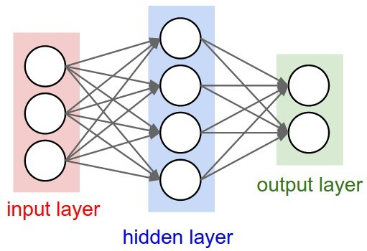
Supervised learning (Inference)
Predict (Label/Dependent variable) given data 𝑿
𝜣_{𝟏}
𝜣_{𝟐}
𝒐𝒖𝒕𝒑𝒖𝒕 = 𝒇(𝚯𝒙 + 𝒃)
𝑿
𝒐𝒖𝒕𝒑𝒖𝒕
source : http://cs231n.github.io/neural-networks-1/
5

Slide 6
Supervised learning (Learning)
Update 𝜣 through gradient of objective function 𝛁𝑱
𝜣_{𝟏}
𝜣_{𝟐}
𝛁𝑱(𝚯; 𝑿, 𝒚)
+ Norm penalty
source : http://cs231n.github.io/neural-networks-1/
6

Slide 7
Norms (Definition)
A way to measure the size of vector
Thus, L1 norm and L2 norm are respectively :

Slide 8
Norms (Example)
𝒙^{𝑻} = [𝟏, 𝟏]
L2 norm 𝒙^{𝟐} + 𝒙^{𝟐}
𝟏 𝟐
𝒙
𝟐
1
𝒙_{𝟐}
𝒙_{𝟏}
L1 norm
𝒙_{𝟏}
+ |𝒙_{𝟐}|
𝒙_{𝟏}
1

Slide 9
Squared L2 Norm
Squared L2 norm is used instead of original L2 norm for regularization in machine learning task
All of the derivatives of the L2 norm depend on the entire vector
The derivatives of the squared L2 norm with respect to each element of 𝒙 each depend only on the corresponding element of 𝒙

Slide 10
Squared L2 Norm

Slide 11
Regularization?
A central problem in machine learning is how to make an algorithm that will perform well not just on the training data, but also on new inputs.
Many strategies used in machine learning are explicitly designed to reduce the test error, possibly at the expense of increased training error.
These strategies are known collectively as regularization.

Slide 12
Regularization…
From Classical ML literature, regularization is known as “any modification we make to a learning algorithm that is intended to reduce its generalization error but not its training error.”
There are many regularization strategies.
Some put extra constraints on a machine learning model, such as adding restrictions on the parameter values.
Some add extra terms in the objective function that can be thought of as corresponding to a soft constraint on the parameter values.
If chosen carefully, these extra constraints and penalties can lead to improved performance on the test set.

Slide 13
Regularization…
Sometimes these constraints and penalties are designed to encode specific kinds of prior knowledge.
Other times, these constraints and penalties are designed to express a generic preference for a simpler model class in order to promote generalization.
Sometimes penalties and constraints are necessary to make an underdetermined problem determined.
Other forms of regularization, known as ensemble methods, combine multiple hypotheses that explain the training data.

Slide 14
Regularization..
In the context of deep learning, most regularization strategies are based on regularizing estimators.
Regularization of an estimator works by trading increased bias for reduced variance.
An effective regularizer is one that makes a profitable trade, reducing variance significantly while not overly increasing the bias.

Slide 15
Parameter Norm Penalties
Many regularization approaches are based on limiting the capacity of models, such as neural networks, linear regression, or logistic regression, by adding a parameter norm penalty Ω(θ) to the objective function J .
We denote the regularized objective function by J˜:
where α ∈ [0, ∞) is a hyperparameter that weights the relative contribution of the norm penalty term, Ω, relative to the standard objective function J(x; θ).
Setting α to 0 results in no regularization. Larger values of α correspond to more regularization.

Slide 16
Norm penalties
Limiting the capacity of models by adding norm penalty
𝛀(𝚯) to the objective function 𝑱
Regularized objective function Penalty term
Original objective function
Not modifying the model in inference phase, but adding penalties to the objective function in learning phase
Also known as weight decay

Slide 17
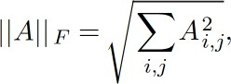
Norms (Matrix norm)
L1 norm and L2 norm are defined for the way to measure size of vector
Sometimes machine learning task would require a size of matrix as well
Frobenius norm is :
A way to measure the size of matrix
Known as ‘Matrix norm’

Slide 18
L2 Parameter Regularization
The L2 parameter norm penalty commonly known as weight decay.
This regularization strategy drives the weights closer to the origin1
by adding a regularization term to the objective function.
In other academic communities, L2 regularization is also known as ridge regression or Tikhonov regularization.

Slide 19
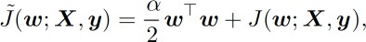
L2 norm Regularization
Substituting squared L2 norm to the 𝛀(𝚯)
| 𝜃 |^{𝟐}
𝟐
Calculating gradient

Slide 20
L2 norm Regularization
Calculating gradient
Applying weight update

Slide 21
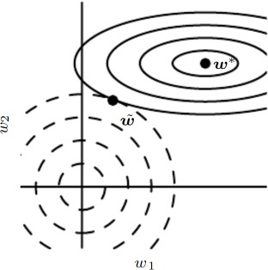



Effect of L2 norm Regularization
Only directions along which the parameters contribute significantly to reducing the objective function are preserved relatively intact.

Slide 22
L2 Parameter Regularization
We can see that the addition of the weight decay term has modified the learning rule to multiplicatively shrink the weight vector by a constant factor on each step, just before performing the usual gradient update.

Slide 23
L1 norm Regularization
Substituting L1 norm to the 𝛀 𝚯
| 𝜃 |_{𝟏}
Calculating gradient

Slide 24
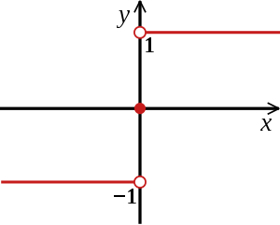
L1 norm Regularization
Substituting L1 norm to the 𝛀 𝚯
| 𝜃 |_{𝟏}
Calculating gradient

Slide 25
Comparison L1 and L2 norm Regularization
The L1 norm is commonly used in machine learning when the difference between zero and nonzero elements is very important
L2 regularization does not cause the parameters to become zero
L1 regularization may cause the parameters to become zero for large enough alpha.

Slide 26
Comparison L1 and L2 norm Regularization
L2 weight decay is the most common form of weight decay.
In comparison to L2 regularization, L 1 regularization results in a solution that is more sparse.
Sparsity in this context refers to the fact that some parameters have an optimal value of zero.
The sparsity of L1 regularization is a qualitatively different behavior than arises with L2 regularization

Slide 27
Norm Regularization without bias
Usually, bias of each weight is excluded in penalty terms
𝑤
The reason is :
The biases typically require less data to fit than the weights
Each weight specifies how two variables interact while biases specify interact of one variables
Regularizing the bias parameters can cause underfitting

Slide 28
Norm Regularization without bias
Usually terms
enalty
, bias of each weight is excluded in p
𝑤
1
𝑏𝑖𝑎𝑠
ℎ
𝑥
𝑤𝑒𝑖𝑔ℎ𝑡
The reason is :
The biases typically require less data to fit than the weights
Each weight specifies how two variables interact while biases specify interact of one variables
Regularizing the bias parameters can cause underfitting

Slide 29
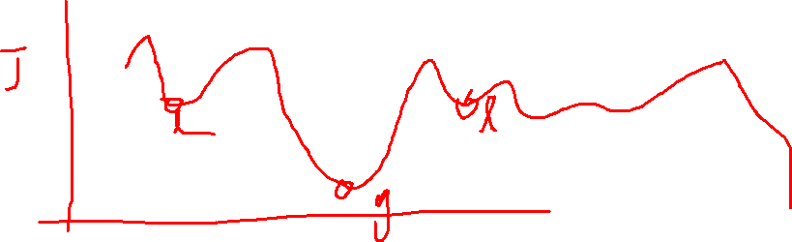
Pros and Cons
Norm regularization doesn’t modify formula of inference phase
Norm regularization sometimes causes local minima

Slide 30
Data Augmentation and Noise Robustness

Slide 31


Introduction to Dataset Augmentation
The best way to make a machine learning model generalize better is to train it on more data
Dataset augmentation is a technique that creating fake data and adding it to the training set
Original data
Artificial data
Image source : https://www.pexels.com/photo

Slide 32
Data Augmentation
Dataset augmentation has been a particularly effective technique for a specific classification problem: object recognition.
Images are high dimensional and include an enormous variety of factors of variation, many of which can be easily simulated. Operations like translating the training images a few pixels in each direction can often greatly improve generalization. Many other operations such as rotating the image or scaling the image have also proven quite effective.
NOTE: One must be careful not to apply transformations that would change the correct class.
For example, optical character recognition tasks require recognizing the difference between ’b’ and ’d’ and the difference between ’6’ and ’9’, so horizontal flips and 180◦ rotations are not appropriate ways of augmenting datasets for these tasks.
There are also transformations that we would like our classifiers to be invariant to, but which are not easy to perform.
For example, out-of-plane rotation can not be implemented as a simple geometric operation on the input pixels.
Dataset augmentation is effect for speech recognition tasks as well

Slide 33
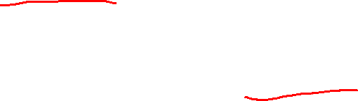
Injecting noise (Training data)
Injecting noise in the input to a neural network (Sietsma and Dow, 1991)
can also be seen as a form of data augmentation.
Injecting random noise into input data to improve robustness
𝜣_{𝟏}
𝜣_{𝟐}
𝒐𝒖𝒕𝒑𝒖𝒕 = 𝒇(𝚯𝒙 + 𝒃)
𝒐𝒖𝒕𝒑𝒖𝒕
Random Noise Filter

Slide 34
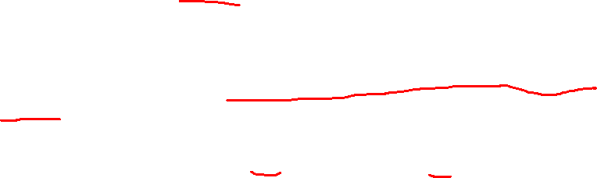
Injecting noise (Weight)
Injecting random noise into weight to improve robustness
This makes the model relatively insensitive to small variations in the weights
𝜣_{𝟏}+ noise
^{𝜣}𝟐 ^{+ noise} 𝒐𝒖𝒕𝒑𝒖𝒕 = 𝒇(𝚯𝒙 + 𝒃)
𝒐𝒖𝒕𝒑𝒖𝒕

Slide 35
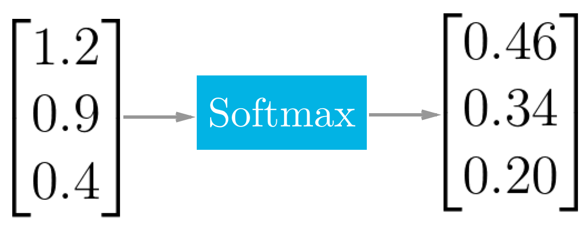
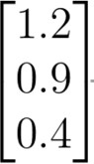
Injecting noise (Label)
Most datasets have some amount of mistakes in the 𝒚 labels
Output probability vector
1
0
0
noise noise noise
Input data vector
Label vector with random noise
Label smoothing regularizes a model based on a softmax with k output values by replacing the hard 0 and 1 classification targets.
Label smoothing has the advantage of preventing the pursuit of hard probabilities without discouraging correct classification

Slide 36
Early Stopping

Slide 37
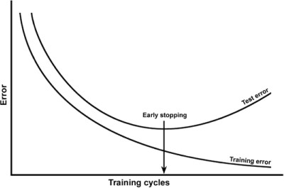
Early Stopping
When training large models with sufficient representational capacity to overfit the task, we often observe that training error decreases steadily over time, but validation set error begins to rise again.
Learning too much iterations causes overfitting

Slide 38
Early Stopping
Instead of running our optimization algorithm until we reach a (local) minimum of validation error, we run it until the error on the validation set has not improved for some amount of time.
Every time the error on the validation set improves, we store a copy of the model parameters. When the training algorithm terminates, we return these parameters, rather than the latest parameters.
This strategy is known as early stopping. It is probably the most commonly used form of regularization in deep learning.
Its popularity is due both to its effectiveness and its simplicity.

Slide 39
Early Stopping
One way to think of early stopping is as a very efficient hyperparameter selection algorithm. In this view, the number of training steps is just another hyperparameter.
The only significant cost to choosing this hyperparameter automatically via early stopping is running the validation set evaluation periodically during training.
Ideally, this is done in parallel to the training process on a separate machine, separate CPU, or separate GPU from the main training process. If such resources are not available, then the cost of these periodic evaluations may be reduced by using a validation set that is small compared to the training set or by evaluating the validation set error less frequently and obtaining a lower resolution estimate of the optimal training time.

Slide 40
Features of Early Stopping
Early stopping regards iteration number as hyper parameter and find optimal value of it.
Computation cost to find optimal iteration number is negligible. This can be parallelized while training process on separate machine.
Early stopping doesn’t affect the formula of cost function.
Early stopping is a very unobtrusive form of regularization, in that it requires almost no change in the underlying training procedure, the objective function, or the set of allowable parameter values.
Early stopping may be used either alone or in conjunction with other regularization strategies.

Slide 41
Features of Early Stopping
Early stopping requires a validation set, which means some training data is not fed to the model.
To best exploit this extra data
one can perform extra training after the initial training with early stopping has completed.
In the second, extra training step, all of the training data is included.
There are two basic strategies one can use for this second training procedure.
One strategy is to initialize the model again and retrain on all of the data. In this second training pass, we train for the same number of steps as the early stopping procedure determined was optimal in the first pass.
Another strategy for using all of the data is to keep the parameters obtained from the first round of training and then continue training but now using all of the data.

Slide 42
Features of Early Stopping
Early stopping is also useful because it reduces the computational cost of the training procedure.
Besides the obvious reduction in cost due to limiting the number of training iterations, it also has the benefit of providing regularization without requiring the addition of penalty terms to the cost function or the computation of the gradients of such additional terms.

Slide 43
How early stopping acts as a regularizer?
early stopping has the effect of restricting the optimization procedure to a relatively small volume of parameter space in the neighborhood of the initial parameter value θ.
More specifically, imagine taking τ optimization steps (corresponding to τ training iterations) and with learning rate ε. We can view the product ετ as a measure of effective capacity.
Assuming the gradient is bounded, restricting both the number of iterations and the learning rate limits the volume of parameter space reachable from θ . In this sense, ετ behaves as if it were the reciprocal of the coefficient used for weight decay.
Early stopping is equivalent to L2 regularization. The number of training iterations τ plays a role inversely proportional to the L2 regularization parameter, and the inverse of τ ε plays the role of the weight decay coefficient. (Refer Page 250-251)

Slide 44
Parameter Tying and Parameter Sharing
Parameter dependency:
𝑳𝟐regularization (or weigh decay) penalizes model parameters for deviating from the fixed value of zero
Sometimes we need other ways to express prior knowledge of parameters
We may know from domain and model architecture that there should be some dependencies between model parameters
The goal of parameter tying
We want to express that certain parameters should be close to one another

Slide 45
A Scenario of parameter typing
Let us imagine that the tasks are similar enough (perhaps with similar input and output distributions) that we believe the model parameters should be close to each other: ∀i, w(A) should be close to w(B) .
We can leverage this information through regularization.

Slide 46
L2 penalty for parameter typing

Slide 47
Parameter sharing
While a parameter norm penalty is one way to regularize parameters to be close to one another, the more popular way is to use constraints: to force sets of parameters to be equal.
This method of regularization is often referred to as parameter sharing, where we interpret the various models or model components as sharing a unique set of parameters.
A significant advantage of parameter sharing over regularizing the parameters to be close (via a norm penalty) is that only a subset of the parameters (the unique set) need to be stored in memory.
In certain models—such as the convolutional neural network—this can lead to significant reduction in the memory footprint of the model.

Slide 48
Multi-Task Learning (MTL)

Slide 49
Two MTL Methods

Slide 50
Parameter Sharing
Parameter sharing forces sets of parameters to be equal
Only a subset of parameters (the unique set) need to be stored in memory (memory efficient than parameter tying, especially in CNN)
Example case : parameter sharing in a convolution layer of CNN

Slide 51
Bagging and Other Ensemble Methods
Bagging (short for bootstrap aggregating) is a technique for reducing generalization error by combining several models (Breiman, 1994).
The idea is to train several different models separately, then have all of the models vote on the output for test examples.
This is an example of a general strategy in machine learning called model averaging.
Techniques employing this strategy are known as ensemble methods.
The reason that model averaging works is that different models will usually not make all the same errors on the test set.

Slide 52
Concept of Bagging

Slide 53
Ensemble Methods
Different ensemble methods construct the ensemble of models in different ways.
For example, each member of the ensemble could be formed by training a completely different kind of model using a different algorithm or objective function.
Bagging is a method that allows the same kind of model, training algorithm and objective function to be reused several times.
Procedure
Split the input data to K clusters with N’ examples (sampling with replacement)
Train a classifier with a random sampled cluster
For testing, take each examples of test data to all classifier
Each classifier votes on the output, take majority

Slide 54
Why Bagging Works?

Slide 55
Why Bagging Works?

Slide 56
Why Bagging Works?

Slide 57
Dropout

Slide 58
Overfitting
Excessive focus on train data, resulting in worse results on actual test data

Slide 59
Solutions for Overfitting
Regularization
L1-norm penalty
L2-norm penalty
Data augmentation
Dropout (2012)
A method of bagging applied to neural networks
An inexpensive but powerful method of regularizing a broad family of models
Batch Normalization (2015)
It is described further in Chapter 8. Optimization

Slide 60
Dropout
Dropout (Srivastava et al., 2014) provides a computationally inexpensive but powerful method of regularizing a broad family of models.
Dropout provides an inexpensive approximation to training and evaluating a bagged ensemble of exponentially many neural networks.
Specifically, dropout trains the ensemble consisting of all sub-networks that can be formed by removing non-output units from an underlying base network.

Slide 61
Dropout
A technique that omits a portion of the network
We can surly improve the performance by model combination like as Bagging concept
However, if neural network is too deep to build the multiple models, it might be costly and inefficient
Also, it takes long time to inference the input with multiple models
Dropout addressed the two problems
Omit the neurons, to mimic the voting in ensemble technique, instead of building the multiple models
Product the probability that a neurons will survive to weight, at inference level

Slide 62
Dropout..

Slide 63
Effect of Dropout
Avoid the co-adaptation
Co-adaptation: the trend that some neurons tend to represent similar features
Capture the clear features by avoiding co-adaptation

Slide 64
Effect of Dropout

Slide 65
Dropout Modeling

Slide 66
Dropout Performance

Slide 67
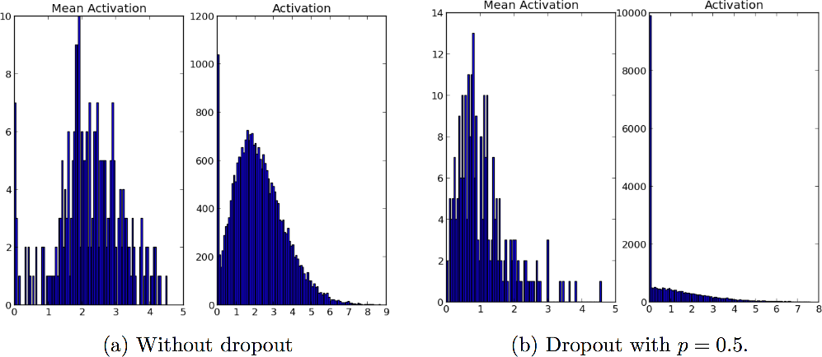
Dropout another effect: Sparsity
Can capture salient features
Makes neurons more sparse
Prevent co-adaptation

Slide 68
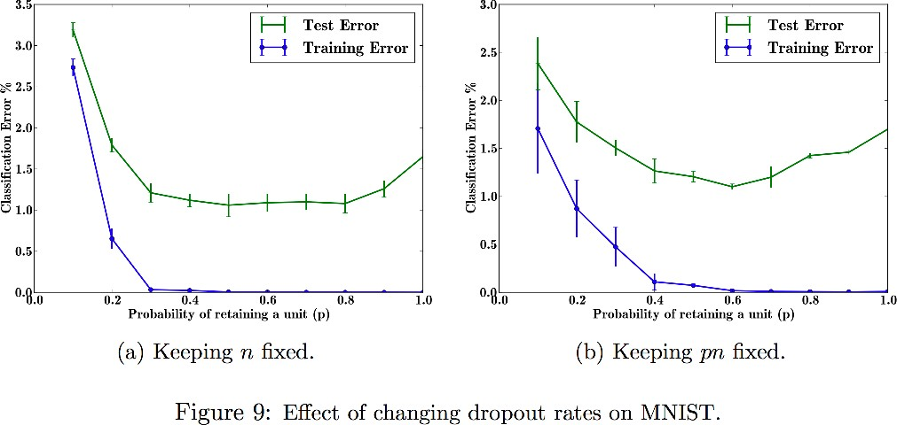
Hyper parameter 𝑝: the Dropout rate
fixed number of neurons, variable 𝑝
Relatively constant test error on 0.4~0.8 → usually use 𝑝 = 𝟎𝟎. 𝟓𝟓
fixed value of 𝑝𝑛
Lower test error on low 𝑝 → increase number of neurons for low 𝑝

Slide 69
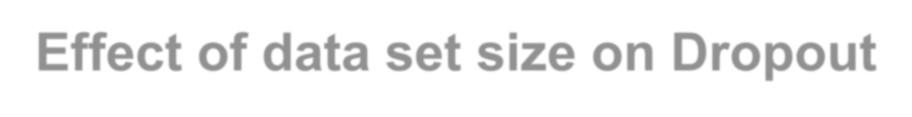
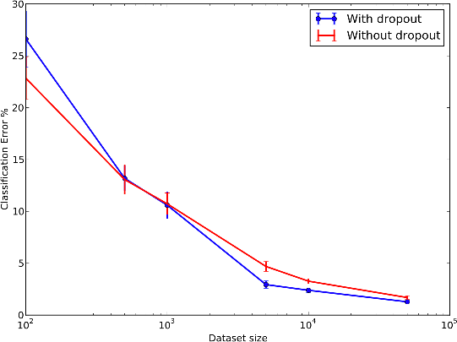
Effect of data set size on Dropout
Dropout is more powerful for larger dataset

Slide 70
Adversarial Training
References:
Goodfellow, Ian J., Jonathon Shlens, and Christian Szegedy. "Explaining and harnessing adversarial examples." arXiv preprint arXiv:1412.6572 (2014).
Szegedy, Christian, et al. "Intriguing properties of neural networks." arXiv preprint arXiv:1312.6199 (2013).

Slide 71
Introduction
In many cases, neural networks have begun to reach human performance when evaluated on an i.i.d. test set.
It is natural therefore to wonder whether these models have obtained a true human-level understanding of these tasks.
In order to probe the level of understanding a network has of the underlying task, we can search for examples that the model misclassifies.
Some studies found that even neural networks that perform at human level accuracy have a nearly 100% error rate on examples that are intentionally constructed by using an optimization procedure to search for an input x’ near a data point x such that the model output is very different at x’.
In many cases, x’ can be so similar to x that a human observer cannot tell the difference between the original example and the adversarial example, but the network can make highly different predictions.

Slide 72

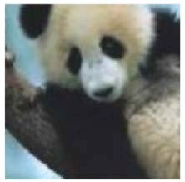
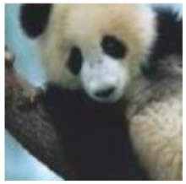
Adversarial Examples
Definition
Applying an imperceptible non-random perturbation to a test image, it is possible to arbitrarily change the network’s prediction
Examples
With the same predict model,
Y = ”panda”
With 0.577 confidence
Y = ”gibbon”
With 0.993 confidence

Slide 73
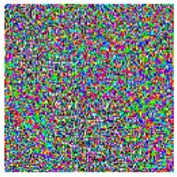
Adversarial Examples
Definition
Applying an imperceptible non-random perturbation to a test image, it is possible to arbitrarily change the network’s prediction
Examples
With the same predict model,
× 0.07
=
Y = ”panda”
With 0.577 confidence
Y = ”gibbon”
With 0.993 confidence
44

Slide 74
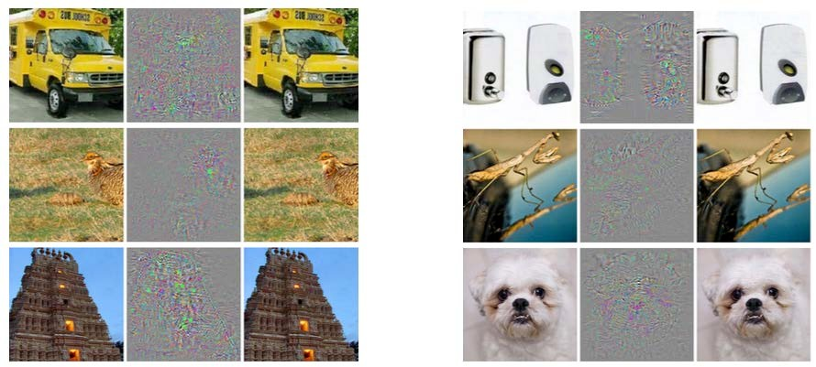
Adversarial Examples
Adversarial examples
Correctly predicted sample

Slide 75
Additional Content
Norm Penalties
as Constrained Optimization

Slide 76
Constrained optimization
Sometimes one may wish to find the maximal or minimal value of 𝒇(𝒙) for value of 𝒙 in some set 𝕊
Constrained region 𝕊
𝒙_{𝟐}
Global optimal
𝒙_{𝟐}
Constrained optimal
𝒙_{𝟏}
𝒙_{𝟏}

Slide 77

Expression of constrained function
To express function with constrained condition is difficult
Constrained region 𝕊
𝒙_{𝟐}
𝒙_{𝟐}
Constrained optimal
𝒙_{𝟏}
𝒙_{𝟏}

Slide 78
Generalized Lagrange function
A possible approach is to design a different, unconstrained optimization problem whose solution can be converted into a solution to the original constrained problem
The unconstrained optimization function is called “Generalized Lagrange function”

Slide 79
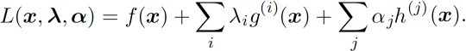
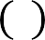
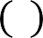
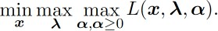
Generalized Lagrange function
Generalized Lagrange function is defined as:
Where the constrained region is:
𝕊 = {𝒙|∀𝒊, 𝒈 ^{𝒊} 𝒙 = 𝟎 𝒂𝒏𝒅 ∀𝒋, 𝒉 ^{𝒋} ≤ 𝟎}
We can find optimal 𝒙 in region 𝕊 by solving:

Slide 80
Norm Penalties with respect to Constrained Optimization
Cost function regularized by a parameter norm penalty
Original cost function
norm penalty, constrained term
If we wanted to constrain 𝛀(𝜽) to be less than some constant 𝒌, we could construct a generalized Lagrange function

Slide 81
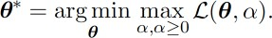
Norm Penalties with respect to Constrained Optimization
Generalized Lagrange function
The solution to the constrained problem is given by
𝑎 must increase whenever 𝛀(𝜽) > 𝒌 and decrease whenever 𝛀(𝜽) < 𝒌

Slide 82
Norm Penalties with respect to Constrained Optimization
To gain some insight into the effect of the constraint, we can fix 𝑎∗ and view the problem as just a function of 𝜽 :
𝜽∗ = 𝒂𝒓𝒈𝒎𝒊𝒏_{𝜽} 𝐿 𝜽, 𝑎∗ = 𝒂𝒓𝒈𝒎𝒊𝒏_{𝜽} [ 𝑱 𝜽; 𝑿, 𝒚 + 𝑎∗𝛀 𝜽 ]
This is exactly the same as the regularized training problem of minimizing 𝑱^{A}

Slide 83
